Slide 1
Scheduling Session 5
Course : COMP6153
Effective Period : September 2018

Slide 2
Sub Topics
Process Behavior
Goals of scheduling
Batch Scheduling Algorithms
Interactive scheduling algorithms
Thread Scheculing

Slide 3
These slides have been adapted from: Stallings, W. (2011). Operating Systems: Internals and Design Principles. 8^{th.} ISBN: 978-0-13-380591-8 Chapter 9
Acknowledgement

Slide 4
Learning Objectives
At the end of this lecture, students are able to:
LO2 : Relate the fundamental design scheduling algorithms to the current development of Operating System
LO 3: Demonstrate different scheduling algorithms

Slide 5
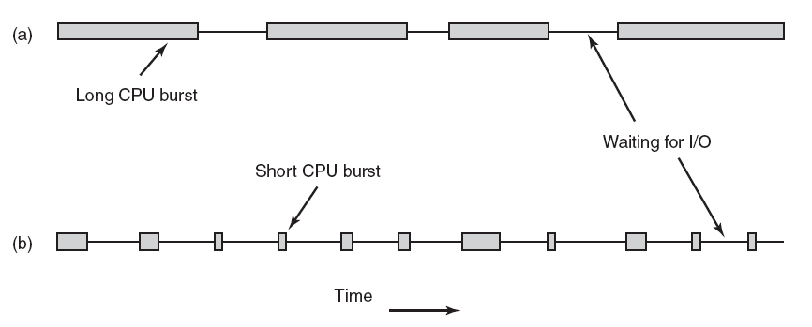
Process Behavior
Process-bound
I/O bound
The basic idea here is that if an I/O-bound process wants to run, it should get a chance quickly so that it can issue its disk request and keep the disk busy.

Slide 6
CPU Scheduler
Selects from among the processes in memory that are ready to execute, and allocates the CPU to one of them.
CPU scheduling decisions may take place when a process:
1. Switches from running to waiting state.
2. Switches from running to ready state.
3. Switches from waiting to ready.
4. Terminates.

Slide 7
Types of scheduler
Long-term scheduling The decision to add to the pool of processes to be executed
Medium-term scheduling The decision to add to the number of processes that are partially or fully in main memory
Short-term scheduling The decision as to which available process will be executed by the processor
I/O scheduling The decision as to which process’s pending I/O request shall be handled by an available I/O device

Slide 8
Dispatcher
Dispatcher module gives control of the CPU to the process selected by the short-term scheduler; this involves:
switching context
switching to user mode
jumping to the proper location in the user program to restart that program
Dispatch latency – time it takes for the dispatcher to stop one process and start another running.

Slide 9
Scheduling Criteria
CPU utilization – keep the CPU as busy as possible
Throughput – # of processes that complete their execution per time unit
Turnaround time – amount of time to execute a particular process
Waiting time – amount of time a process has been waiting in the ready queue
Response time – amount of time it takes from when a request was submitted until the first response is produced, not output (for time-sharing environment)

Slide 10
Optimization Criteria
Max CPU utilization
Max throughput
Min turnaround time
Min waiting time
Min response time

Slide 11
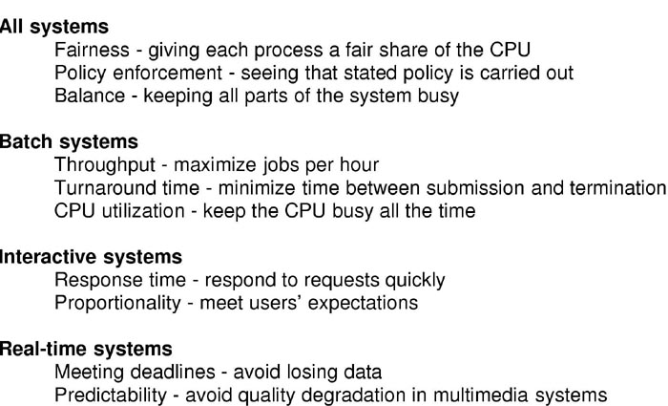
Goals of scheduling

Slide 12
Batch Scheduling algorithm (1)
First-Come First-Serve
Processes are assigned the CPU in the order they request it
Adv:
Easy to understand and easy to program
Disadv:
Short job may wait too long if long job is in front of it

Slide 13
Batch Scheduling algorithm (2)
First-Come First-Serve
Process Burst Time
P₁ 24
P₂ 3
P₃ 3
Suppose that the processes arrive in the order: P₁ , P₂ , P₃ The Gantt Chart for the schedule is:
Waiting time for P₁ = 0; P₂ = 24; P₃ = 27
Average waiting time: (0 + 24 + 27)/3 = 17
P₁
P₂
P₃
0
24
27
30

Slide 14
Batch Scheduling algorithm (3)
Shortest Job First
Associate with each process the length of its next CPU burst. Use these lengths to schedule the process with the shortest time.
Two schemes:
nonpreemptive – once CPU given to the process it cannot be preempted until completes its CPU burst.
preemptive – if a new process arrives with CPU burst length less than remaining time of current executing process, preempt. This scheme is know as the Shortest-Remaining-Time-First (SRTF).
SJF is optimal – gives minimum average waiting time for a given set of processes.

Slide 15
Batch Scheduling algorithm (4)
Shortest Job First – Non Preemptive
Process Arrival Time Burst Time
P₁ 0.0 7
P₂ 2.0 4
P₃ 4.0 1
P₄ 5.0 4
SJF (non-preemptive)
Average waiting time = (0 + 6 + 3 + 7)/4 = 4
P₁
P₃
P₂
P₄
0
3
7
8
12
16

Slide 16
Batch Scheduling algorithm (5)
Shortest Job First – Preemptive
Process Arrival Time Burst Time
P₁ 0.0 7
P₂ 2.0 4
P₃ 4.0 1
P₄ 5.0 4
SJF (preemptive)
Average waiting time = (9 + 1 + 0 +2)/4 = 3
P₁
P₂
P₃
P₂
P₄
P₁
0
2
4
5
7
11
16

Slide 17
Interactive Scheduling Algorithm (1)
Round-robin scheduling
Priority scheduling
Multiple queues
Shortest process next
High Response Ratio Next
Feedback

Slide 18
Interactive Scheduling Algorithm (2)
Round Robin with time slice = 20
Process Burst Time Arrival Time
P₁ 53 0
P₂ 17 20
P₃ 68 25
P₄ 24 30
The Gantt chart is:
P₁
P₂
P₁
P₃
P₄
P₁
P₃
P₄
P₃
P₃
0
20
37
57
77
97
110
130
134
154
162
P2 P1 P3 P4 P1 P3 P4 P3 P3
P1 P3 P4 P1 P3 P4 P3
P4 P1 P3 P4

Slide 19
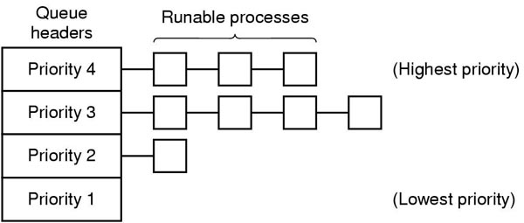
Interactive Scheduling Algorithm (3)
Priority Scheduling
Each process is assigned a priority, and the runnable process with the highest priority is allowed to run
The scheduler may decrease the priority of currently running process
Priority scheduling is used among classes and round-robin scheduling within each class

Slide 20
Interactive Scheduling Algorithm (4)
Multiple Queue
Priority class of queuing processes
Quantum given: 1, 2, 4, 8, 16 …
Why?
To reduce swapping
i.e. long CPU-bound process eventually get large quantum
short, interactive process get small quantum
Example:
Process with quantum 100
Quantum given: 1, 2, 4, 8, 16, 32, 64 (used 37) ⇒ only 7 swap

Slide 21
Interactive Scheduling Algorithm (5)
Shortest Process next
Need to estimate the time of the next processes
i.e. aT₀ + (1−a)T₁
where T₀ is the estimated time of the first command
T₁ is that of the next command
…
With a = ½, add the new value to the current estimate and divide the sum by 2
Estimates:
T₀ , T₀/2+ T₁/2 , T₀/4+ T₁/4+ T₂/2, T₀/8+ T₁/8+ T₂/4+ T₃/2

Slide 22

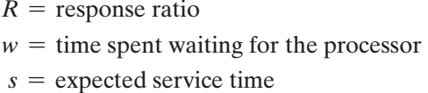
Interactive Scheduling Algorithm (6)
High Response Ratio Next
Consider the following ratio:
The Rules:
When the current process completes or is blocked, choose the ready process with the greatest value of R.
This approach is attractive because it accounts for the age of the process.
While shorter jobs are favored (a smaller denominator yields a larger ratio), aging without service increases the ratio so that a longer process will eventually get past competing shorter jobs.

Slide 23
Interactive Scheduling Algorithm (8)
Feedback
Scheduling is done on a pre-emptive (at time quantum) basis
dynamic priority mechanism is used. When a process first enters the system, it is placed in RQ0.
After its first pre-emption, when it returns to the Ready state, it is placed in RQ1. Each subsequent time that it is pre-empted, it is demoted to the next lower-priority queue.
A short process will complete quickly, without migrating very far down the hierarchy of ready queues.
A longer process will gradually drift downward. Thus, newer, shorter processes are favoured over older, longer processes.
Within each queue, except the lowest-priority queue, a simple FCFS mechanism is used. Once in the lowest-priority queue, a process cannot go lower, but is returned to this queue repeatedly until it completes execution

Slide 24
Real Time Scheduling
Schedulable real-time system
Given
m periodic events
event i occurs within period P_{i} and requires C_{i} seconds
Then the load can only be handled if
Example:
A soft real time system with three periodic event, with periods of 100, 200, and 500 ms. If these events require 50, 30, and 100 ms of CPU time per event → the system is schedulable because
0.5 + 0.15 + 0.2 < 1

Slide 25
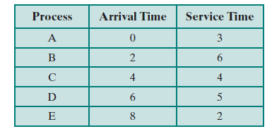
Comparison of Schedling algorithms (1)
Example:

Slide 26
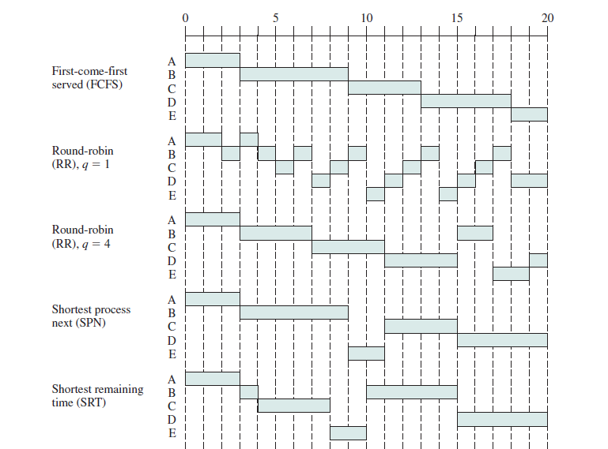
Comparison of Schedling algorithms (2)

Slide 27
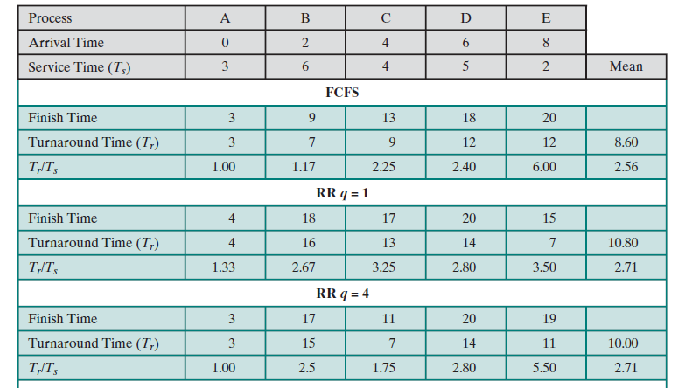
Comparison of Schedling algorithms (3)

Slide 28
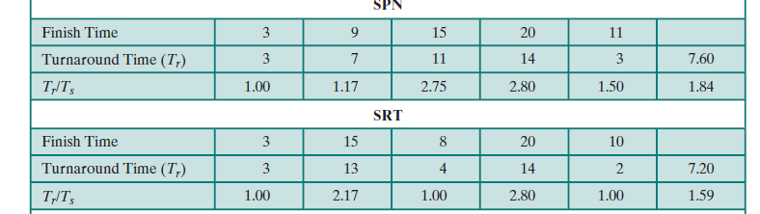
Comparison of Schedling algorithms (4)

Slide 29
Policy vs Mechanism
Separate what is allowed to be done with how it is done
a process knows which of its children threads are important and need priority
Scheduling algorithm parameterized
mechanism in the kernel
Parameters filled in by user processes
policy set by user process

Slide 30
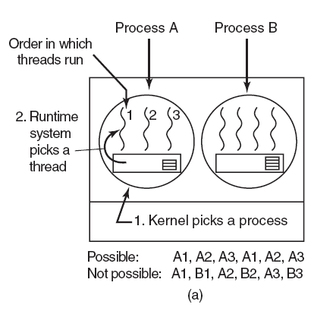
Thread Scheduling (1)
(a) Possible scheduling of user-level threads with a 50-msec process quantum and threads that run 5 msec per CPU burst.

Slide 31
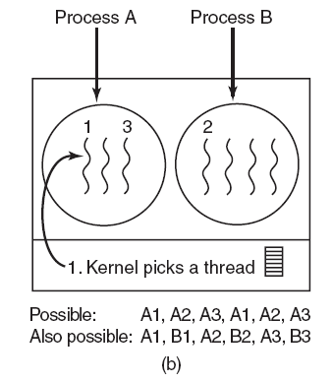
Thread Scheduling (2)
(b) Possible scheduling of kernel-level threads with the same characteristics as (a).

Slide 32
References
Stallings, W. (2014). Operating Systems: Internals and Design Principles. 8^{th.} ISBN: 978-0-13-380591-8
Abraham Silberschatz, Peter B. Galvin, Greg Gagne (2012). Operating System Concepts 9th ed.
ISBN: 978-1118063330
A. Tanenbaum(2007), Modern Operating System, 3rd
ISBN: 978-0136006633

